Slide 1

DSA 210 Project Subject: Hours of Sleep and Caffeine Intake, and their effect on Hours of Study and Exercise
Emre Çavuş
32326

Slide 2
Motivation
As someone who loves coffee, I have always believed that after a certain threshold (in terms of cups per day), sleep quality and duration are significantly affected. One of my main motivations for this project is to validate or challenge this assumption through data analysis.
Another key motivation is to find whether there is a correlation between the combination of daily caffeine levels, and sleep duration, and daily study & exercise hours.

Slide 3
Data Collection
I’ve collected data for 64 days which had the following attributes:
Hours of Sleep 💤
# of caffeine intake (mostly it represents the cups of tea and coffee) ☕
Hours of Study 📚
Hours of Exercise 🏃‍♂️

Slide 4
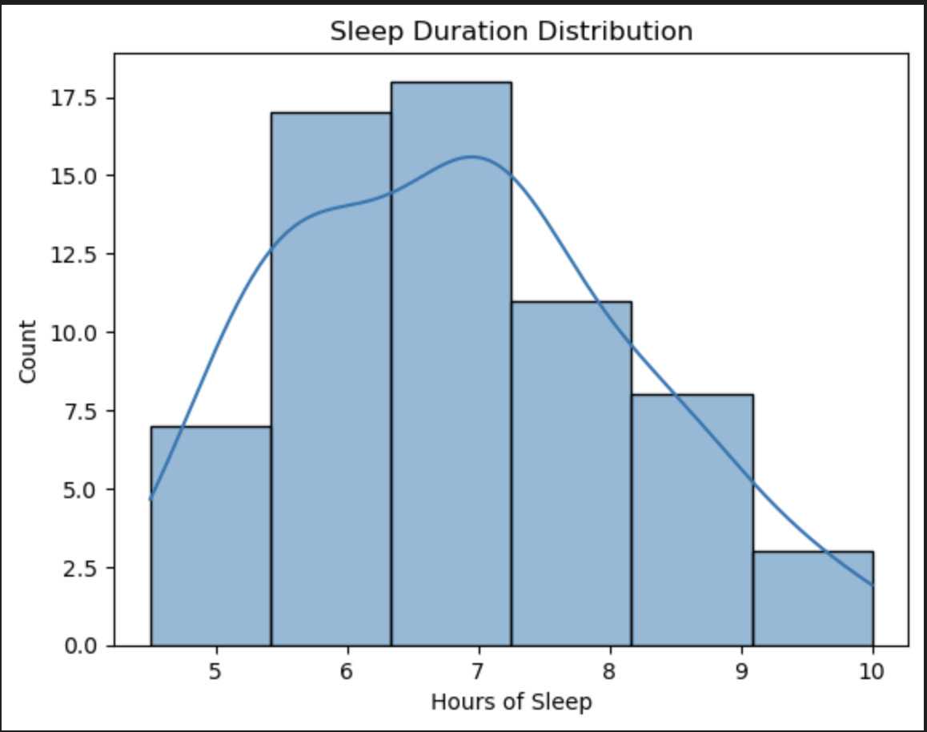
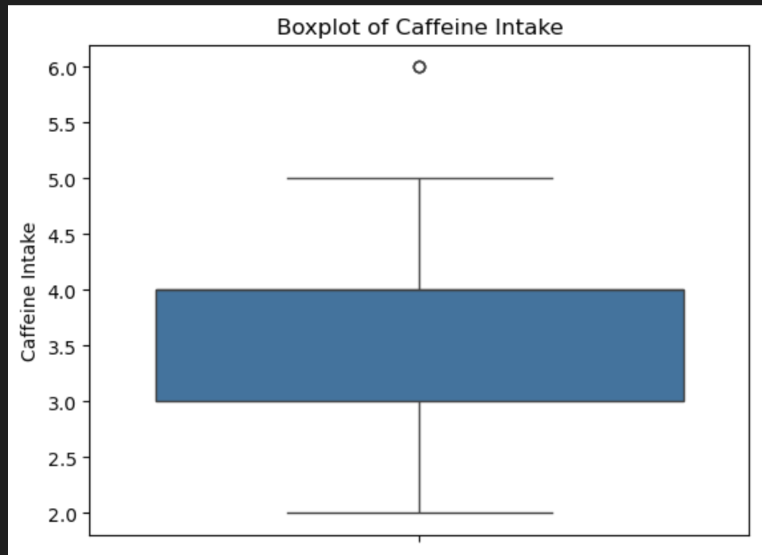
Exploratory Data Analysis
I’ve plotted histograms and boxplots of these variables to see the univariate distributions of the attributes.
For example, the hours of sleep has a right skewed distribution which can be seen from the histogram. Also, the caffeine intake has some outliers that can be seen from the boxplot.

Slide 5
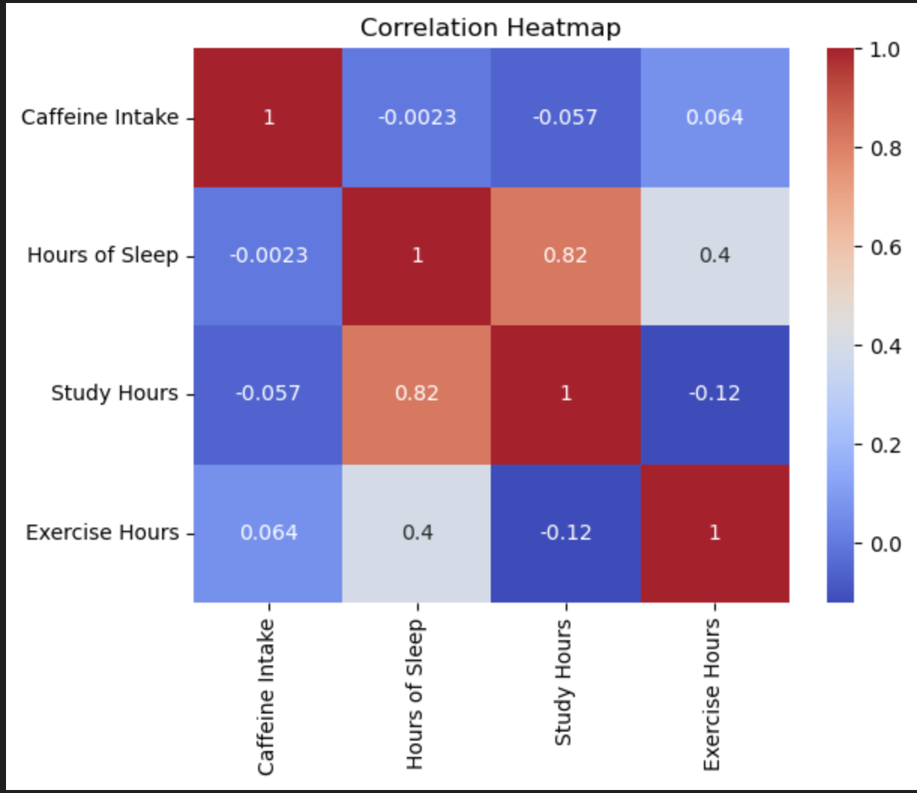
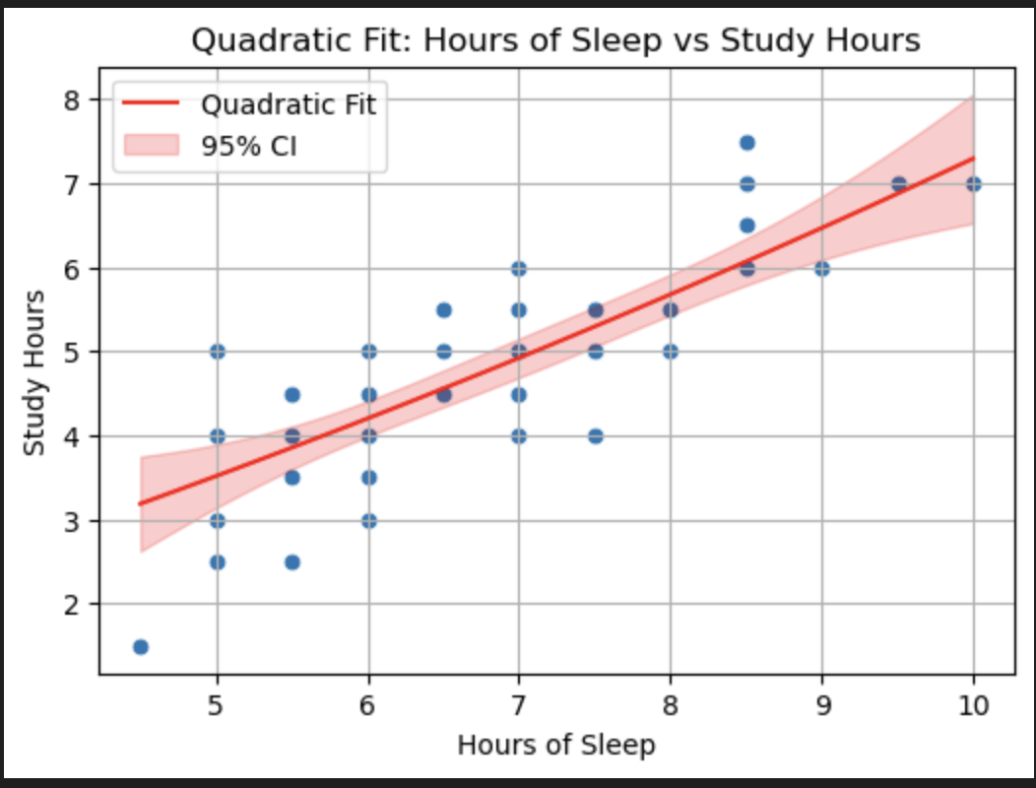
Bivariate Analysis
I’ve also plotted correlation heatmaps and scatterplots to see how the attributes are correlated with each other and is there anything significant that I can use in my EDA and ML models.
While doing scatterplots, in order to represent the relationship between Hours of Sleep and Study Hours (which had the highest correlation), I used confidence intervals in both of my linear and quadratic fits.

Slide 6
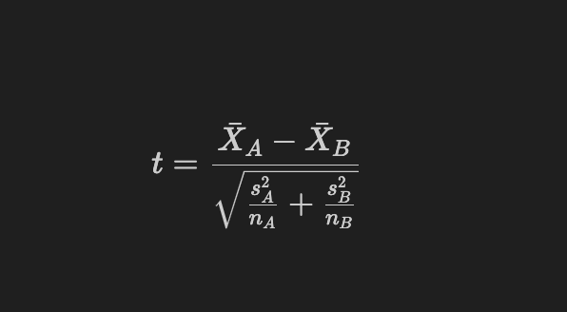
Hypothesis Testing
I’ve had two hypotheses, the first one is regarding the relationship between the sleep level and the study hours. I’ve done a data preprocessing to categorize the Hours of Sleep as low vs high. In this case, 6.5 hours is the threshold.
H₀: The mean of study hours of the low and high level sleep groups are the same.
Hₐ: The mean of study hours of the low level sleep group is less than the mean of the high level sleep group.
Two sample t-statistic is used.

Slide 7
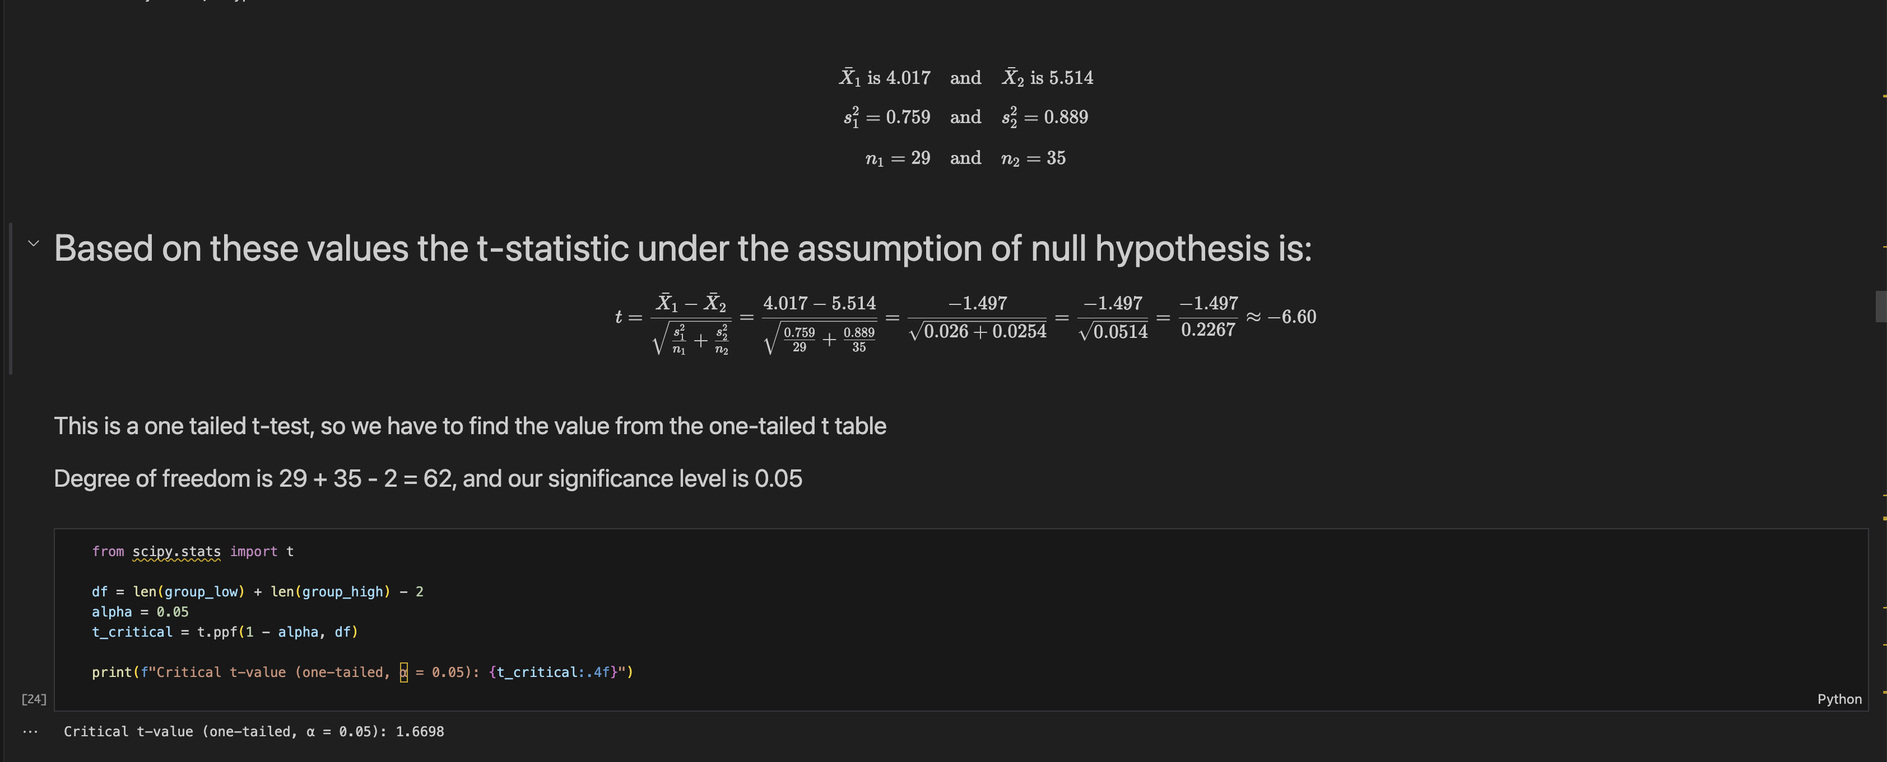
The t-statistic became -6.60, and the critical value is 1.67; which means we reject the null hypothesis.
It statistically proves that the higher hours of sleep lead to higher hours of study.

Slide 8
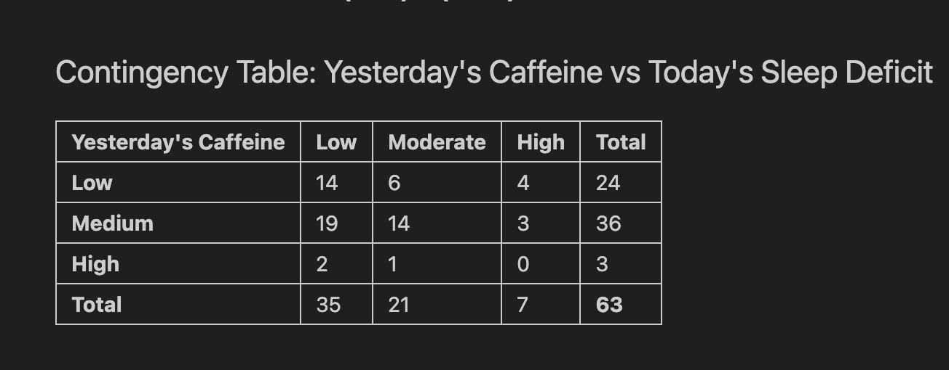
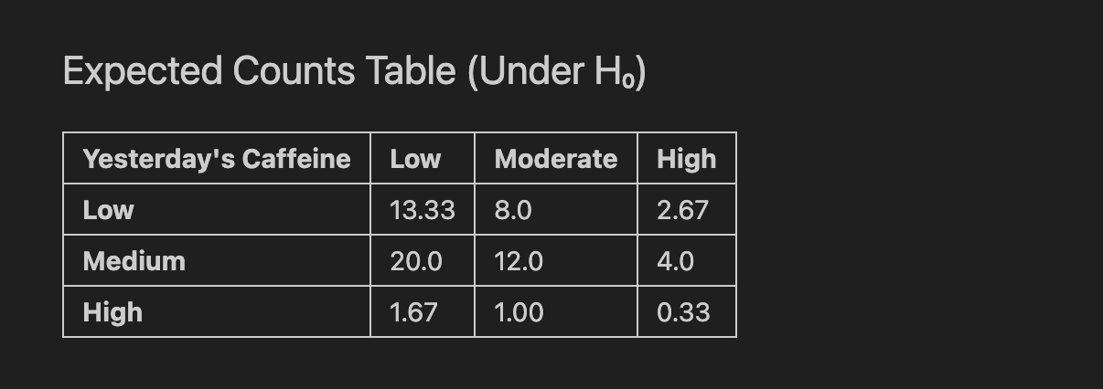
The second hypothesis I had was to measure whether yesterday’s caffeine intake and today’s sleep deficit are dependent or not.
I’ve applied some data preprocessing to derive the attributes yesterday’s caffeine intake and today’s sleep deficit.
H₀: Yesterday's caffeine and Today's sleep deficit are independent
Hₐ: Yesterday's caffeine and Today's sleep deficit are dependent
Here are the contingency table and the expected values:

Slide 9
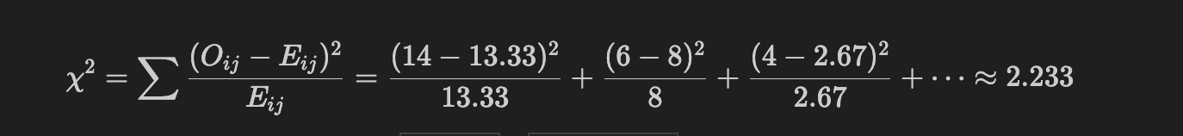
I’ve used chi-square statistics, and our observed statistic became 2.233, and the critical value is 9.488, which means we fail to reject the null hypothesis.
There is no statistical proof to state the dependence of caffeine taken yesterday and sleep deficit today.

Slide 10
Machine Learning Integration
Before I started training models, I’ve applied One Hot Encoding on the categorical variables, as I cannot use them as they are in the regression models.
I’ve used three regression types: Linear Regression, Decision Tree Regressor, and Polynomial Regression.
The evaluation metrics used are Root Mean Squared Error, Mean Absolute Error and R^2.

Slide 11
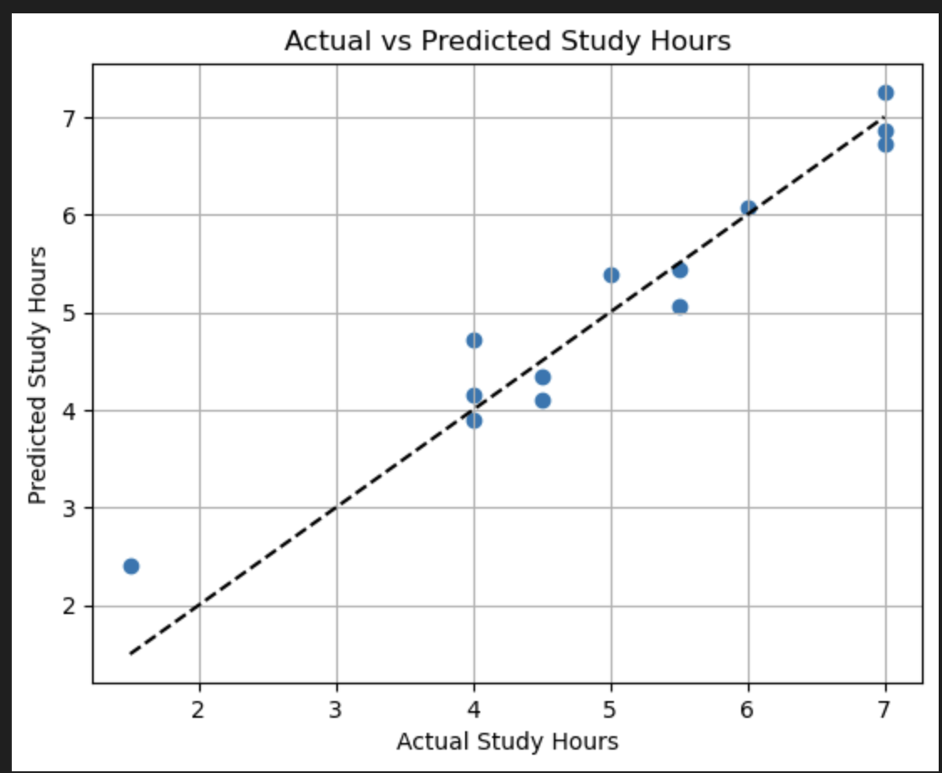
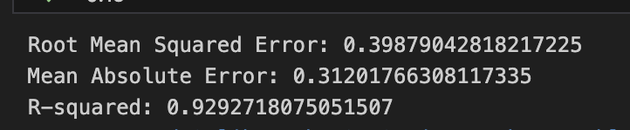
Linear Regression

Slide 12
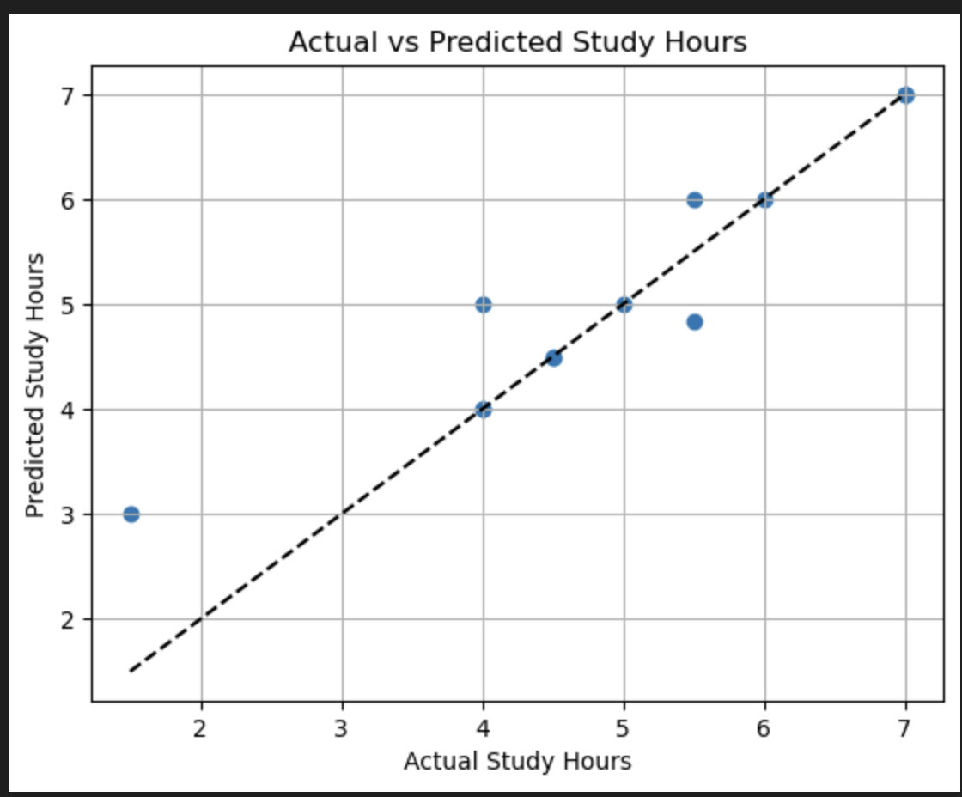
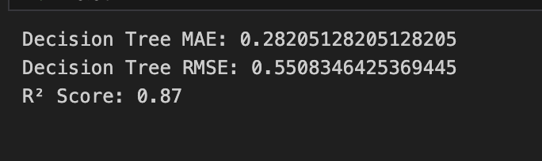
Decision Tree Regressor

Slide 13
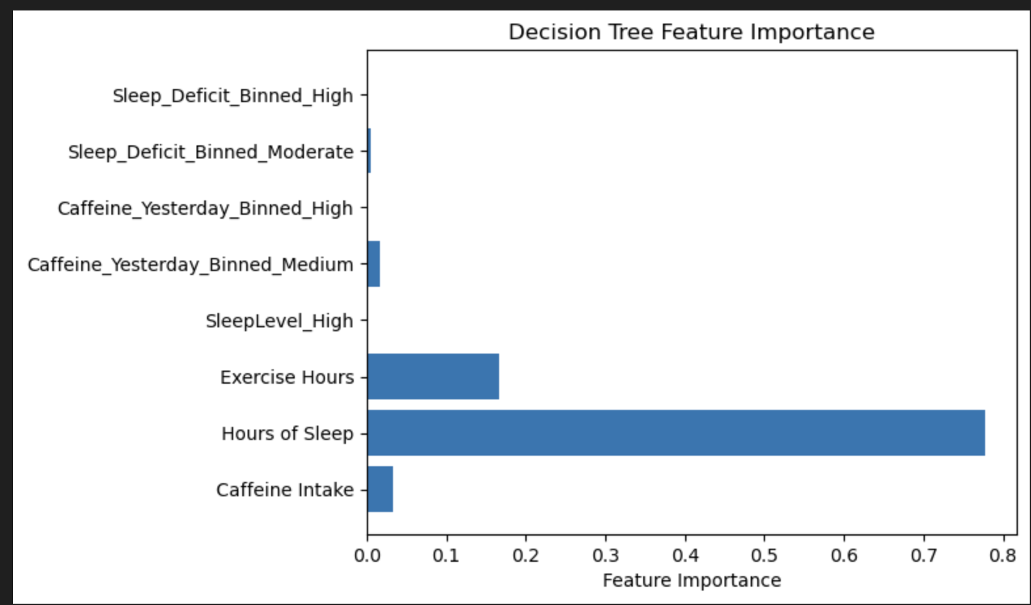
In decision tree models, we can derive the features with the most importance as well. The feature that captures the variance of the variable to be predicted the most.

Slide 14
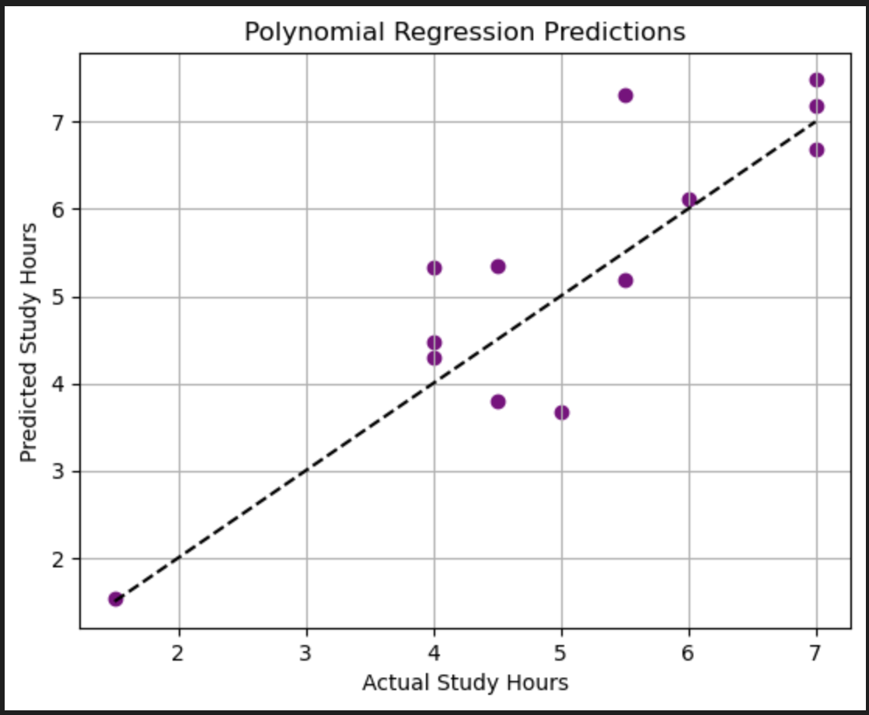
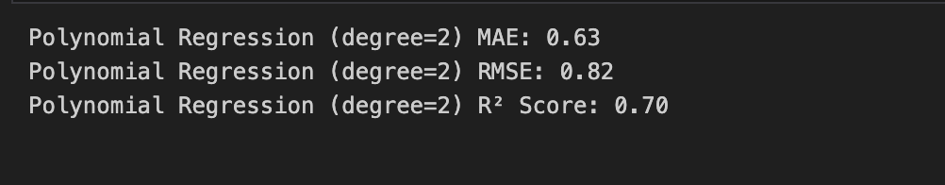
Polynomial Regression

Slide 15
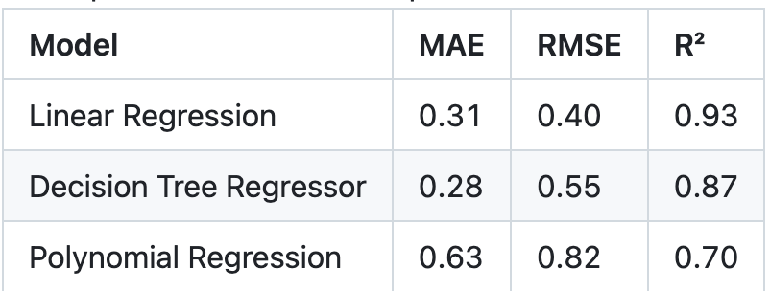
Findings
The evaluation metrics showed that the highest R² value was present on the linear regression model. Thus it was more successful at capturing the variance of the hours of study compared to decision tree regressor and the polynomial regression models.
It also had the least amount of error in both RMSE and MAE evaluation metrics, further emphasizing its success.

Slide 16
Limitations & Future Work
The dataset is limited in size (about 6 weeks) and reflects a single individual's habits — generalizability is limited.
Some data points (like sleep quality) are self-reported, which may introduce bias.
In future work, I plan to:
Expand the dataset with additional participants
Track more precise physiological data (e.g., heart rate, sleep tracking apps)
Add time-of-day to the equation as well (morning coffee vs. evening coffee)

